Slide 1

Introduction
Industrial IoT
Software and Services Group
IoT Developer Relations, Intel

Slide 2
Legal Notices and Disclaimers
Intel technologies’ features and benefits depend on system configuration and may require enabled hardware, software or service activation. Performance varies depending on system configuration. No computer system can be absolutely secure. Check with your system manufacturer or retailer or learn more at www.intel.com.
This document contains information on products, services and/or processes in development. All information provided here is subject to change without notice. Contact your Intel representative to obtain the latest forecast, schedule, specifications and roadmaps.
Any forecasts of goods and services needed for Intel’s operations are provided for discussion purposes only. Intel will have no liability to make any purchase in connection with forecasts published in this document.
ARDUINO 101 and the ARDUINO infinity logo are trademarks or registered trademarks of Arduino, LLC.
Intel, the Intel logo, Intel Inside, the Intel Inside logo, OpenVINO, Intel Atom, Celeron, Intel Core, and Intel Movidius Myriad 2 are trademarks of Intel Corporation or its subsidiaries in the U.S. and/or other countries.
*Other names and brands may be claimed as the property of others.
Copyright 2018 Intel Corporation.
2

Slide 3
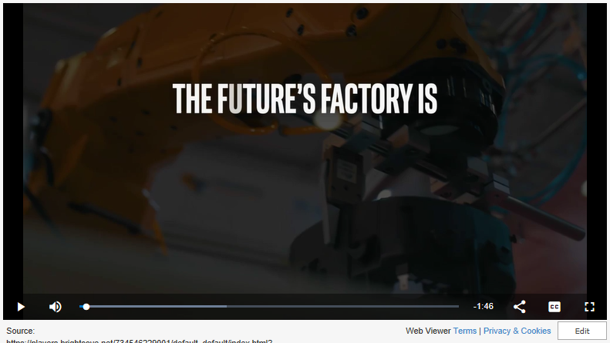
FUTURE’s FACTORY
Notes:
Optional: Videos to excite the audience.
The 1st video is 1m48s and does a good job of being upbeat and exciting.
The 2nd video is 2m35s and is excellent at briefly summarizing IIoT.

Slide 4
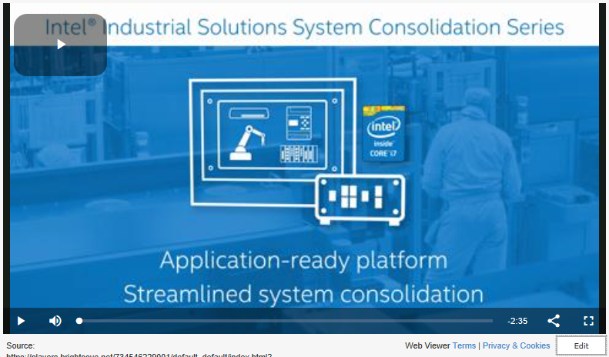
INDUSTRIAL VISION
Notes:
Optional: Videos to excite the audience.
The 1st video is 1m48s and does a good job of being upbeat and exciting.
The 2nd video is 2m35s and is excellent at briefly summarizing IIoT.

Slide 5
IIOT Workshop Overview
Introduction
Physical Sensors and Actuators
Communications and Protocols
Control
Intel Dev Program and Products
Introduction to Intel and the IIoT
Workload Consolidation
Security
Operations
Each Module contains a lecture and a hands-on lab exercise that builds towards an model of an IIoT infrastructure based on a formalized architecture.
Information
Predictive Analytics and Data Modeling
Industrial IoT Workshop Content: https://goo.gl/Stt9mD
Notes:
IIoT Workshop Overview
This slide gives a brief outline of the material covered in the Intel Industrial IoT Workshop. You can use this slide to give a quick overview of the topics and will be covered.
You can always find the latest course outline on Github.
https://github.com/SSG-DRD-IOT/Industrial-IoT-Workshop
Topics
Introduction to the Industrial Internet of Things and the workshop including:
Overview of the topics and the hardware
What is Industry 4.0?
What business opportunities and solutions will Industry 4.0 provide?
What are the key technologies that enable new value in Industry 4.0?
Continuous Visibility into business processes by deploying physical sensors and using analytics, digital twins and machine learning creates a Virtuous Cycle.
What Pilot Opportunities can your business begin to harness the Industrial IoT
Formalizing the IIoT – We will give an overview of the Industrial Internet Consortium (IIC) and create a architecture based on their whitepapers.
Physical Sensors and Actuators – We will explore the hardware sensors in the Up2 Grove IoT Development Kit and use Arduino Create to build a couple of sensor based labs
Communications and Protocols – We will talk about scalability in a IIoT network and three protocols MQTT, OPC-UA and DDS
Automation – Reactions based on sensor data
Smart Video System – the Intel CV SDK which includes OpenVX and OpenCV as well as the deep learning kit and the inference engine.
Machine Learning, Predictive Analytics, and Business Analytics will be written for the 2 day workshop.
Industrial IoT or Industry 4.0 has arrived at the doorstep many of the industrial companies and going forward high investment will flow into new digitalization processes changing the way the industrial ecosystem will operate. This workshops is an introduction in the concepts and formal architectures of Industry 4.0. The workshop is divided into modules. Each Module contains a lecture and a hands-on lab exercise that builds towards a test prototype of an IIoT infrastructure based on the Industrial Internet Consortium’s IIoT Reference Architecture and Intel technology.
In the second module, we will introduce a formal structure for realizing an IIoT deployment. The later modules fit

Slide 6
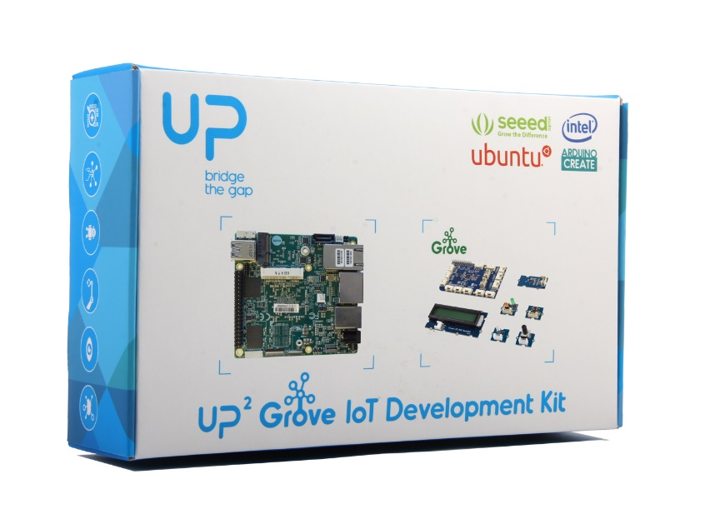
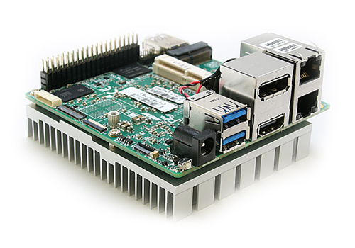
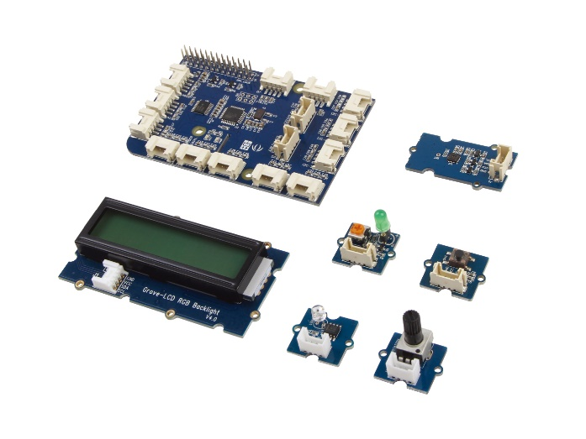
Introducing the Up2 Grove Iot Development kit
High-Performance Features
Fast CPU and graphics capabilities
Multiple displays, Dual network ports
Many I/O expansion options
Integrated Software
Preinstalled Ubuntu* 16.04
Over 400 sensor libraries
Integration for major third-party cloud providers
Development
Develop simply with Arduino Create*
Optimize code with Intel® System Studio

Slide 7
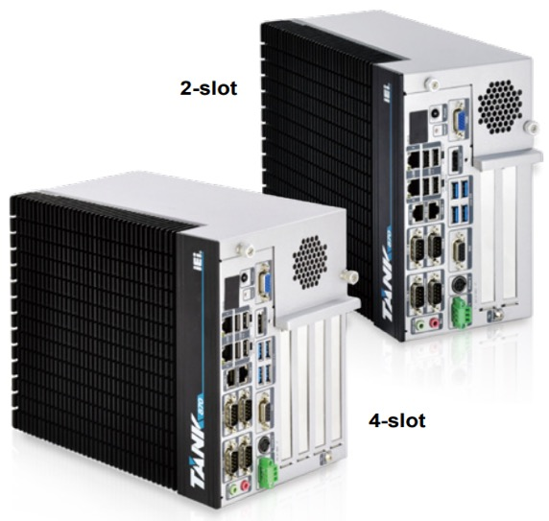
IOT Client (Core) Foundation Dev Kit - Starting at $1,250
Official product name: IEI Tank AIoT Dev Kit
Sub messaging/title: Accelerate to the future
https://software.intel.com/en-us/blogs/2018/06/13/introducing-the-tank-aiot-developer-kit
The IOT Client Foundational Kit will provide manageability, performance, and a scalable rapid path to market solution that will support advanced computer vision and deep learning usages.
Availability: EOQ2’18
IEI Tank-870-Q170 (2-slot)
PCIe slots that will support HDDL-F (FPGA) and HDDL-RC (Myriad X)
http://eshop.usa.ieiworld.com/usa/items.php?CA=2&sub_CA=24
Specs:
Dimensions: 5” (121.5mm) x 10” (255.2mm) x 8” (205mm)
Weight: 13.9lbs (6.3kg)
Core i5 (Sky Lake at launch then convert to Coffee Lake Q4’18)
Kaby Lake Gen Gfx driver incompatible with CV SDK
Fanless
8GB of RAM
1TB HDD
2x PCIe x8
LAN1: Intel® I219LM PCIe controller
LAN2 (iRIS): Intel® I210 PCIe controller
WIFI/BT : Realtek RTL8821AE : 1T1R wifi module kit for embedded system, IEEE802.11a/b/g/n/ac WiFi with Bluetooth 4.0/3.0+HS, 1 x wifi module, 2 x 400mm RF cable, 2 x Antenna, RoHS
I/O Ports: 4x USB 3.0, 4 x USB 2.0, 4x RS-232, 2x RS-232/485, 8-bit DIO, 1x Line-out, 1x Mic-in
Operating Temp: -20°C~60°C

Slide 8
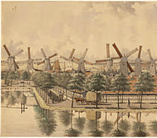
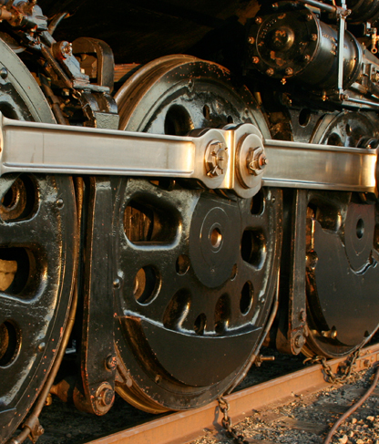
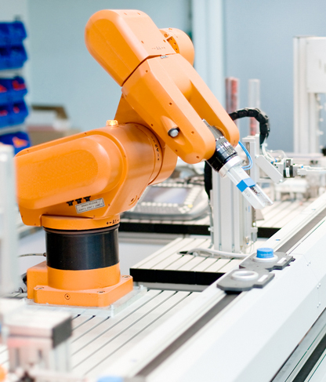
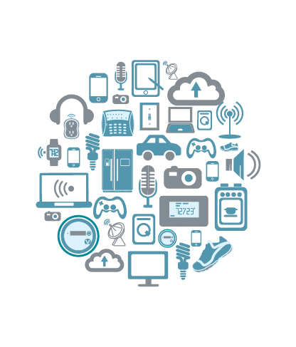
industrial Revolution 4.0
1st
2nd
3rd
4th
1760’s
1860’s
Late 1900’s
nOW
Steam, Water Mechanized Production
Electrification, Oil, Mass Production
Invention of the Microchip
Invention of the computerized network
Notes:
Industrial Revolutional 4.0
If you do a search for Industry 4.0, you will find many versions of a story that puts Industry 4.0 into a historical context of technological revolutions.
1st Industrial Revolution: This is what you were original taught in school and it was label as the “The Industrial Revolution.” Back in the 1800’s the steam and water power moved mechanical production and transportation. Sawmill, flourmills, mechanized butter churns and many automatic technologies for producing goods begin to appear. Interesting most of these technologies were based upon natural and renewable sources. They were also unfortunately limited to area that provided these resources. Mills were in a forest and next to the river that provided the power to turn a waterwheel, which turned crankshaft going into the mill, that was geared down to provide the mechanical power to needed cut, pounding, shredding, hacking or mixing raw material into tradeable product like paper and lumber and milled flour. Amsterdam became known for the windmill which even though the technology is considerably more advanced now, wind still powers the turbines and pumps that move hold the ocean back beyond the dikes of Holland.
2nd Industrial Revolution: The second industrial revolution begin with new chemical based methods of production. Instead of being next the river and using hydraulic potential energy, you could transport coal, oil and different chemical fuels and stores of energy to the location of your choice. Methods of transporting energy and products became more important and let to the train or then sometimes called the “iron horse”. This revolution saw and increase in the production of steel and also saw an increasing in inventive banking techniques. ended about 100 hundred years later and is defined as the era of mass production, famously exemplified by Henry Ford and his automotive assembly line. Mechanization also increased in the processing and refining of fuels and lubracants The goal was through division of labor here was to create many, many copies of the same product, reducing the cost and making the products available, affordably to many people.
3rd Industrial Revolution: Begin in the 1970’s when microprocessors because small, cheap and robust enough to aid in the automation of computerize manufacturing processes.
4th Industrial Revolution: Is this world of cyber-physical systems where the systems are connected and able to communicate with each other and also they are able to sense their environment and coordinate reactions with the state of the physical world. Parts, Part Distribution, manufacturing, assembly, distribution, dealer networks, OEM and though the lifecycle out to the customer themselves. This allows them to contribute to huge pools of information which big data and analytics can condense into actionable business actions.
The Internet of Things (IoT) comprises many emerging technologies that enable wireless interconnections among “things” (usually objects such as personal devices, appliances, cars, or industrial equipment, but also living things such as animals and people) equipped with data-gathering sensors. Early predictions indicate that the number of IoT devices could reach 26 billion worldwide by 2020 (Lee and Lee, 2015), but this estimate is likely to increase as more companies are jumping on the IoT bandwagon. One of the greatest predicted impacts of IoT is in industrial settings – where it will help transform entire industries by creating new opportunities for companies to manage their internal processes and interact with customers (Iansiti and Lakhani, 2014). These industrial IoT technologies and applications are denoted by the term Industry 4.0. Accenture predicts that collecting data from sensors placed on products, equipment, and even users, and using this data to improve processes inside and outside organizations “can add trillions of dollars to the global economy by 2030.” (Purdy and Davarzan, 2015).

Slide 9




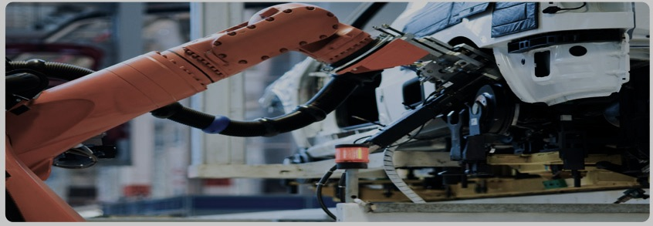

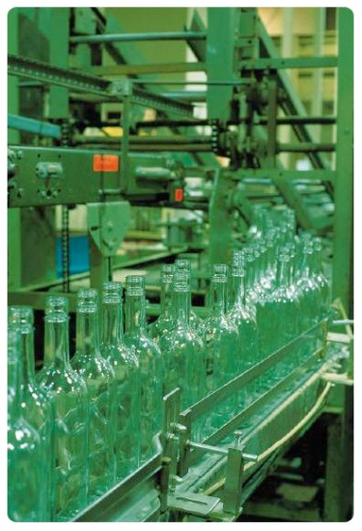
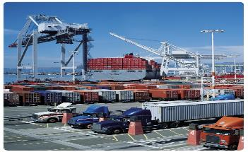
Industrial customers are asking …
How can I
capture knowledge for my transitioning workforce?
How Can I Better Innovate?
I need to improve
I need to achieve
Real Time
Visibility
How Do I
Improve workforce
productivity?
How Can I
How can I have better visibility to manage my
Introduce new IOT solutions faster?
Product
Quality.
How can I
Reduce
Downtime?
Global Supply Chain?
Notes:
Industrial leaders are digitizing essential functions within their internal vertical operations processes, as well as with their horizontal partners along the value chain. In addition, they are enhancing their product portfolio with digital functionalities and introducing innovative, data-based services. Both of these growth areas are starting with business increasing their visibility into the manufacturing, business and operating processes.
Visibility is the first key theme and the beginning of Industry 4.0.
At the end of this transformation process, successful industrial companies will become true digital enterprises, with physical products at the core, augmented by digital interfaces and data-based, innovative services. Both the vertical and horizontal value chains will be remade with software-defined, standards based, real-time, data driven solutions. These digital enterprises will work together with customers and suppliers in industrial digital ecosystems.
These developments will fundamentally change individual companies, as well as transform market dynamics across a whole range of industries. And that’s true in countries all around the world – in both the developed as well as the emerging markets.

Slide 10
Visibility Leveraged for decision making
“While manufacturers have long had access to data collected on the plant. floor, it's typically been locked away in proprietary manufacturing software silos, restricting their ability to leverage it for decision making, according to Matt Wells, product general manager for automation software at GE Digital, based in San Ramon, Calif. That changes with IoT, which makes it far easier to collect and manage large amounts of manufacturing data not just in a single factory, but across multiple production sites through the cloud, he said. When paired with analytics, companies will gain better insights, allowing them to optimize plant operations, reduce quality defects and perform preventative maintenance, according to Wells.”
Matt Wells, product general manager for automation software at GE Digital, based in San Ramon, Calif.
Notes:
Here’s is a quote from Matt Wells, a product general manager for automation software at GE Digital.

Slide 11



Industrial IoT
Industrial processes are taking on a dual nature, one physical and the other digital.
Together Industry 4.0 runs on Cyber-Physical machines.
WHAT?
Sensors are connecting our tools to their physical environment. The Internet of Things is connecting our tools to each other, and large scale computing is connecting our tools to us through optimization of process and analytics.
IIoT is about decoupling devices from applications and gaining visibility into business processes. When each manufacturing device can provide data about it’s use and status then manufacturing processes can be dynamically configured and reconfigured by a data-driven, software processes. Manufacturing will be able to move faster, be more flexible, meet higher work safety standards and fulfill higher quality standards.
WHY?
How?
Working through Industrial Consortiums and Open Industrial Standards to connect current industrial processes to physical sensors, secure protocols, new safety standards, virtualization, real-time automation and machine learning will able visibility and optimization of current business processes.
Notes:
What
The term ‘Industry 4.0’ stands for the fourth industrial revolution. Other related terms include the ‘Industrial Internet’ or the ‘Digital Factory’, although neither takes as complete a view. While Industry 3.0 focused on the automation of single machines and processes, Industry 4.0 focuses on the end-to-end digitization of all physical assets and integration into digital ecosystems with value chain partners. Generating, analyzing and communicating data seamlessly underpins the gains promised by Industry 4.0, which networks a wide range of new technologies to create value.
The proliferation of IoT solutions, and the introduction of smart sensors in many diﬀerent verticals, has expanded the available data, and thereby increased the opportunities to derive benefit from predictive maintenance and asset monitoring. Real-time patterns in a collection of sensor output can predict the failure of a critical system or device. Automatically analyzing other sources of data, such as satellite imagery, can make for a secure and eﬀective infrastructure, such as an oil pipeline. Once a company in an industry implements these benefits, they gain an advantage over their competition. The other companies are left with the option to catch up, or to lose ground.
Creating smart factories generates many opportunities for operational efficiencies, asset tracking, and process improvements. But it also allows organizations to develop new products with greater efficiency and effectiveness, and get them to market faster and less expensively. OEMs can have a much better understanding of a machine’s life cycle and the way customers use them to ensure overall equipment efficiency, and to provide new, highly profitable services and recurring revenues through smart product features. Real-time machine information allows other organizations— financial institutions, insurance companies, consumables vendors, and others —to create new smart services and smart business models to maximize return on invested capital for the industrial assets, and the creation of new intangible assets.
Industry 4.0 encompasses 3 major topics
1. The Digitalization and Integration of the Vertical and Horizontal Value Chains. Horizontally, from their suppliers to their customers and vertically across the company from product engineering to manufacturing and service.

Slide 12
Technology enables New Value
Silicon Based Security
Human-Machine Interfaces
IoT
Data Center Computing
Smart Sensors
Augmented Reality
Mass Customization
Wearables
3gfdhdgdyehgD Printing
Artificial Intelligence
Secure Device Onboard
People, products and machines continuously communicate to optimize process and value chains.
Digitalization of highly vertical processes and equipment. Integration of reusable horizontal capabilities backed by industry consortiums
The product holds the information to its own production and guides itself through Industry 4.0 factories.
Digital business models enable new revenue streams including direct to customer data and product services
Deepen relations with customers through data analytics and mass customization
First movers are set to outpace their competitors
Data Analytics and Business Intelligence as a Platform Capability
Digitize Business Model
Industry 4.0
Digitize Value Chain
Digitalize Product Offerings
Notes:
Technology enables New Value
Many of the technologies that changing the way that we do business are talked about when we are speaking about Industry 4.0. (List the technologies around the circle). These tends to change 3 different aspects of business. Those are the business model, the product lifecycle, asset and machine lifecycle and operation and the worker safety.
Industry 4.0 - from talk to action The buzz around Industry 4.0 has moved from what some saw as PR hype in 2013 to investment and real results today. Respondents expect to significantly increase their portfolios of digital products and services; more than twice as many expect to be at an advanced level in this area by 2020 compared to today. Investment plans are extremely ambitious, with first movers in particular already making significant Industry 4.0 investments and realizing both above-average digital revenues and operational savings. Their plans for the next five years are even more ambitious and far-reaching, with digital products and services paving the way for disruptive business models.
Digitization drives quantum leaps in performance Companies that successfully implement Industry 4.0 no longer need to choose between focusing on a better top or bottom line. They can improve both at the same time.
PLC/PAC and DCX - Satisfy real-time industrial control requirements, distribute control, and consolidate applications using an Intel® processor.
Industrial PC (PCI) - Protect development investments by reusing the same software code base across your product line.
Human Machine Interface (HMI) - Develop or integrate attractive and easy-to-use applications that take advantage of on-chip graphics engines.
Robotics - Reduce hardware BOM cost by running control and user interface functions on a single board.
Machine Vision - Analyze images faster with high-performance Intel® processors and specialized software libraries.
Functional Safety - Keep industrial workers safe by implementing software that protects against the unexpected.
Motion Control - Precisely control position, velocity, and torque while adding intelligence to industrial equipment.
Wearables - Create an incredible experience with computers the size of a suit button and Intel® RealSense™ technology

Slide 13
Cycle of Continuous Smart Manufacturing
Introspection
Sensors, Monitors, Smart Cameras and EMS System provide information about current state
Analysis
AI, machine learning and statistical methods extract high level information from data
Reconstruction
Digital Twins are modeled based on the state of the system
Cognition
Path finding algorithms predict the equipment and processes next in manufacturing
Automation
Network control, physical actuation, updating EMS System
Digitization and integration of vertical and horizontal value chains enables continuous visibility and feedback with the processes across an organization
Connected Inspector
Data Scientist
Connected Worker
Logistics Manager
Industrial Modeler
Notes:
Digitization and integration of vertical and horizontal value chains Industry 4.0 digitizes and integrates processes vertically across the entire organization, from product development and purchasing, through manufacturing, logistics and service. All data about operations processes, process efficiency and quality management, as well as operations planning are available real-time, supported by augmented reality and optimized in an integrated network. Horizontal integration stretches beyond the internal operations from suppliers to customers and all key value chain partners. It includes technologies from track and trace devices to real-time integrated planning with execution.
In smart manufacturing applications, a multi-agent approach can be used. Here, the research focus is on design techniques for automation systems to improve scalability, fault tolerance and latency in discrete and continuous manufacturing. Therefore control systems design and implementation is investigated as a crucial building block of the Smart Factory concept.

Slide 14
Industrial 4.0 Pilot Opportunities
Digital Business Models
Engineering
Vertical Integrations
Horizontal Integrations
Smart Maintenance
Digital Workforce
Digital Sales & Marketing
Hardware Optimization Service Model
Pay as you Go Models
Complete Platform Management Model
Big Data Analytics
Performance Management
Agile Prototyping
Virtualization
Xeon to FPGA Embedded Technology
Scalable Device Management
Simulation & Digital Twin Modeling
Machine Automation
E2E Product Lifecycle Management
Smart Building Management
Energy Optimization
Connected Logistics
Digital Parts and Equipment Sourcing
Smart Warehousing and Logistics
Visibility into Supply Chain
Integrated E2E Planning and Execution
Intrinsic E2E Security
Predictive Maintenance
Simulation of Digital Twin
Augmented Reality
Wearables
FUSA
Integrate ERP Systems
Digital Finance and Accounting
Connected Agile IT
Augmented Reality
UX Interface Support
Digital Customer Relations Management
Customer Service Portals
Personalized Marketing
Dynamic Pricing
E-Payment Systems
Notes:
Stewart, Intel Fan failure analysis

Slide 15
The PATH to Industry 4.0
Build a Digital Enterprise
Create initial pilot projects
Define the capabilities that you need
Gaining Visibility into Your Process?
What is Industry 4.0?
Actively Pursue an Ecosystem Approach!
Notes:
So we’re begin to move along this path of industry 4.0 and it’s important to start with the basic questions. What is Industry 4.0? Is it simply putting sensors on all my equipment and looking at the data? Is it using the data to more closely track a roadmap that a project team has laid out? Is it able modeling my industrial processes in the cloud? Is it about improving worker safety?
Bosche’s manufacturing tools group developed a connected torque wrench that assembly line workers can use in building products on an assemble line. The sensors in the torque wrench identifies the specifications for the part, sends the cloud, and the cloud instructs the wrench to automatically apply the correct level of torque. Mistakes – especially operator error – can be essentially eliminated, even on a dynamic production line and risk of a worker accident is reduced. In addition, the cloud will keep a record of all the elements that affect quality: materials, machines, tools and people. For the torque wrench, the cloud automatically captures the torque applied to a specific part, the specific wrench that was used, when that wrench was last calibrated and the employee who used it. If a company later learns that the wrench was faulty in some way, the cloud can identity every part affected and a recall can be both fast and keenly focused on just the relevant products. (Reference: http://i40.bosch-si.com/)
Industry 4.0 is about the advantages of gaining visibility into your industrial, manufacturing and business processes.
Having real-time data also enables new revenue models.
Rolls-Royce and General Electric partnered together to manufacture jet engines that can be sold as a service, rather than simply a product. Packaged into regular costs for airline buyers are maintenance and upgrades, with IoT systems telling them when to take action.
Meanwhile, Michelin uses sensors on customers’ delivery trucks to help human experts suggest more efficient travel and sell tires based on the number of miles driven.

Slide 16
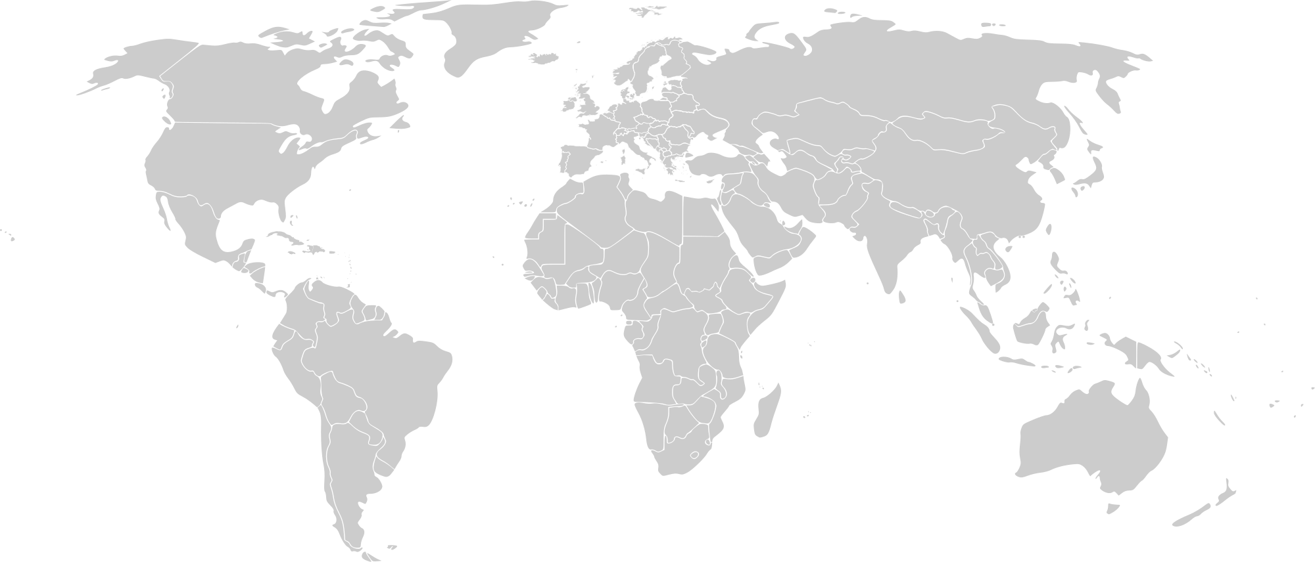
Government Action
UK—The govt. awarded a $135.98M funding to 38 automotive R&D projects to help in the development of next-generation driverless and low-carbon vehicles.
Russia—The Moscow mayor's office and a consortium of Russian mobile operators are in discussion for the creation of a 5G consortium in the hopes of having 5G networks by 2020.
Canada—Innovation, Science and Economic Development Canada plans to launch a public consultation on releasing large amounts of spectrum to support development and deployment of 5G networks.
China—China to focus on smart manufacturing by integrating the strategies of Made in China 2025 and Internet Plus Initiative (which would integrate mobile internet, cloud computing, big data, and IoT innovation into other industries to create new industries and business opportunities).
Australia & Germany—The Australian Prime Minister’s Industry 4.0 Taskforce and Platform Industry 4.0 from Germany collaborated to advance both countries’ manufacturing sectors by focusing on areas such as Industry 4.0 Test labs and security of networked systems.
France—The govt. set up a blockchain working group to research implementations
South Africa—As part of South Africa’s strategy to gain competitive advantage in 3D printing and create jobs in industries such as additive manufacturing and gas & energy, the Industrial Development Corporation invested ~US$1.2M in Metal Heart to make metal 3D printers for production.
US—New York allowed testing of AVs on public roads; started to accept applications from companies interested in testing AVs.
Notes:
Add Germany story

Slide 17
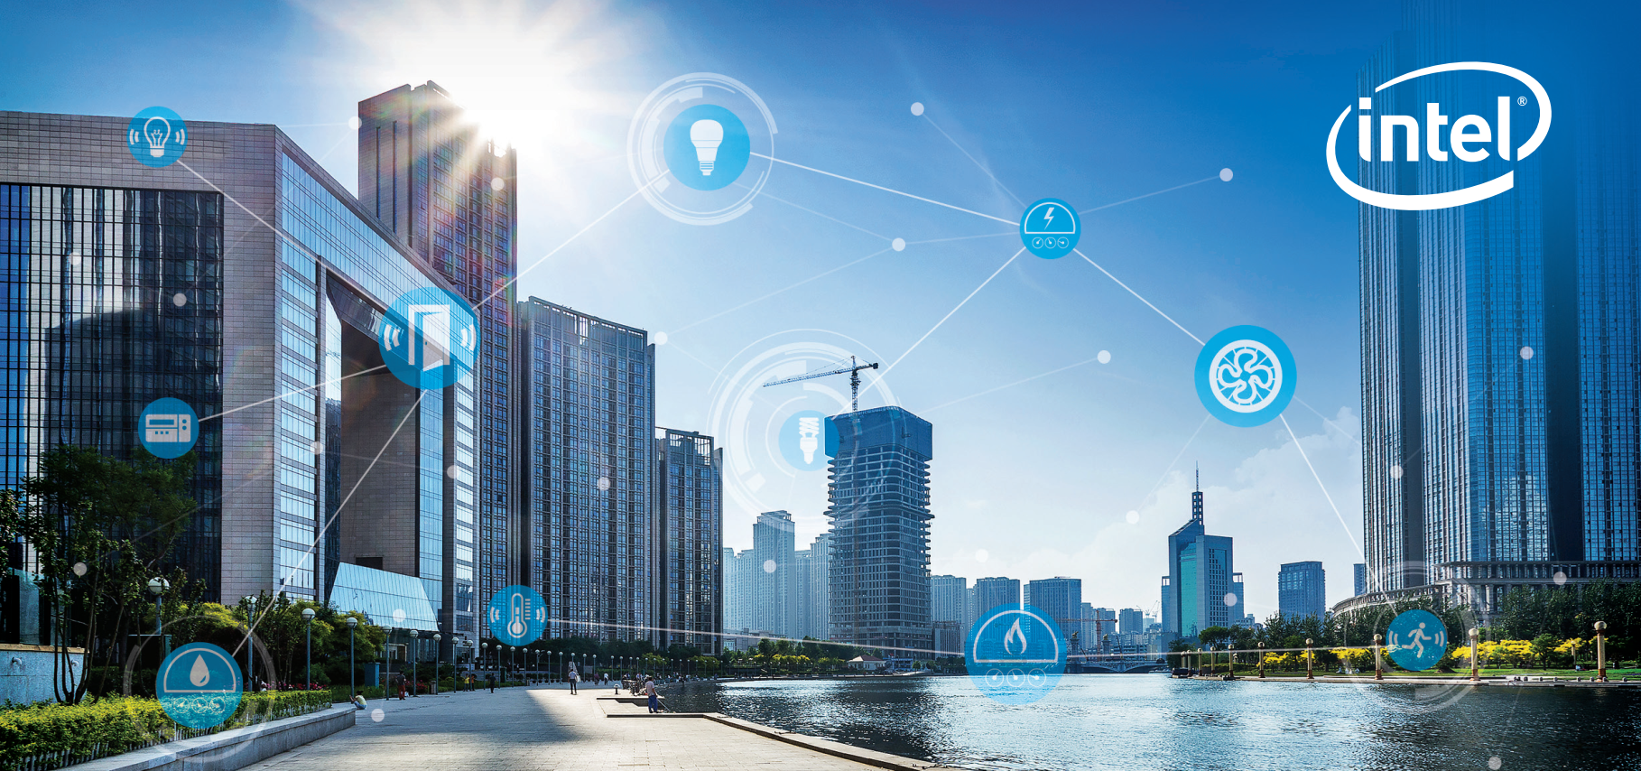
vision for Industrial IoT
Notes:
Intel is transforming from a PC company to a company that powers the cloud and billions of smart, connected computing devices. These devices will use the power of Intel technology to process data being generated from “things,” connect to and learn from data being analyzed in the cloud, and deliver amazing new experiences.
As the Internet of Things evolves, we see three distinct phases emerging. The first is to make everyday objects smart – this is well underway with everything from smart toothbrushes to smart car seats now available. The second is to connect the unconnected, with new devices connecting to the cloud and enabling new revenue, services and savings. New devices like cars and watches are being designed with connectivity and intelligence built into the device. The third is just emerging when devices will require constant connectivity and will need the intelligence to make real-time decisions based on their surroundings. This is the “autonomous era,” and machine learning and computer vision will become critical for all kinds of machines.
Intel’s goal is to lead the industry in transforming businesses and the way we live by making it simple to create exciting, new IoT solutions.
(source https://newsroom.intel.com/editorials/intel-acquires-computer-vision-for-iot-automotive/)

Slide 18
Intel Technology for Industrial IoT/Industry 4.0
Open Platform
Interoperability
Performance at the Edge
Advanced Security
built with interfaces and APIs that enable integration with legacy systems and devices and with platforms from multiple vendors.
is designed into IA CPUs to offer backward compatibility to help SW and application reuse thus reducing development time and resources.
that enables near-real-time analytics, local decision making, and tighter process controls.
for trusted data from edge to cloud and protection from costly attacks.
Scalability
Manageability
Faster, More Flexible Deployment
for varying levels of gateway performance, with a broad range of support from Intel® Quark™, Intel® Atom™, Intel® Core™ and Intel® Xeon® processor D and E families.
for secure remote upgrades and services.
with a platform that supports your choice of operating systems and ecosystem applications.
Notes:
Why choose Intel -based technology for your solution?
First of all, it's an open platform. You're not going to be locked into proprietary hardware and software. It has interoperability with the existing assets you already own. It already will work with your data center and the software running in your data center because 98% of the data centers in the world run on Intel architecture. It enables significant performance at the edge so we can push compute so we can run analytics at the edge, which is a lower cost way to implement this solution. You get less networking and you get better reaction time.
Intel offers security from the hardware in the device, to the edge, to the cloud. You can embed the security in the hardware as well as the software that goes with it. Intel security solutions are constantly running analytics to look for threats and break ins – it’s a solution that not only protects, but also detects and corrects the security in the ever-changing world of threats.
The Intel system is scalable. We’ve proven that by scaling Intel architecture from personal computers to servers and data centers. The cloud scaled with it. The Internet scaled with it. And we can scale with IOT.
And Intel technology is built with manageability in mind. You already own software that manages an Intel-based system: you can reuse your asset. Your investment in people. You already know how to do this. Therefore you're going to get a faster, more flexible deployment.

Slide 19
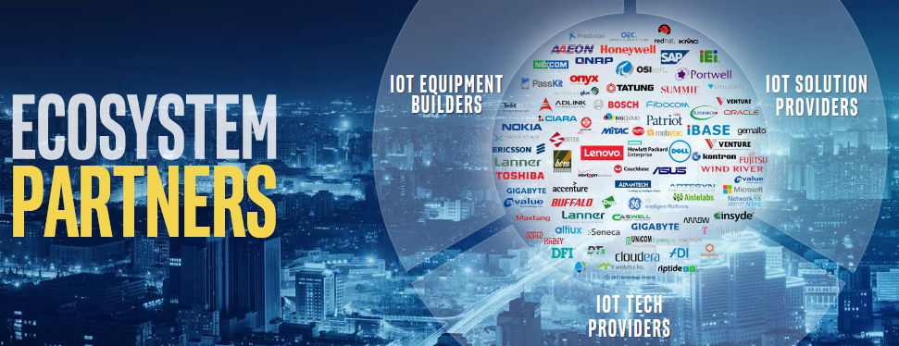

Intel is Partnering with the Ecosystem
* Other names and brands may be claimed as the property of others.

Slide 20
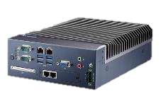
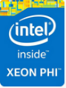
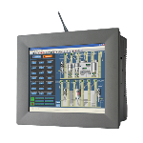
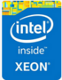
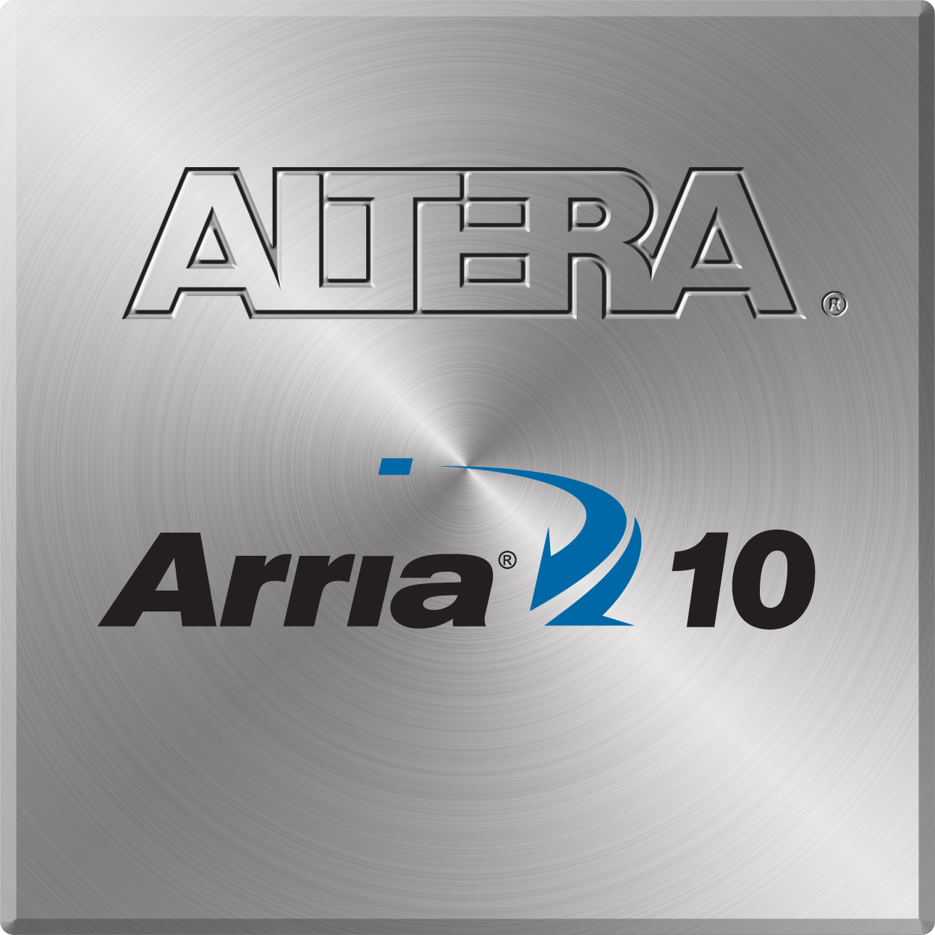
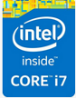
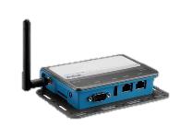
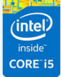
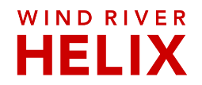
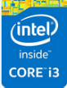
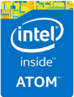
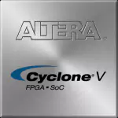
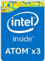
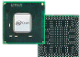



IoT end-to-end scalability with Intel
Level 3: Workflow
Control & Automation
Industrial PC, SCADA
Power
TITANIUM
CONTROL
Altera®
Arria
10-Series
Level 2: Monitoring, Supervisory Control, & Automated Control
PLC, Machine Vision,
HMI, Motion Control
Intel® Xeon® Processor and Intel® Xeon Phi™ Coprocessor
Altera®
Cyclone
V-Series
Performance
Cross-Platform Capabilities
ECC Capabilities
Extended Temp (-40º to 85ºC)
10+ Year Product Support
Trusted Execution Environment
Protected Boot and Storage
Device and SW Identification
Level 1: Sensing & Manipulation
PAC, Data
Acquisition
Intel® Core™ Processor
Altera®
Max 10
Series
Intel® Atom™ Processor
Intel® Quark™ U-Series
M-Core SoCs
Capabilities
Notes:
Add fpga, sw solutions, feature highlights (ecc, ext temp, 10+ yr support)
Remove quark, add movidius

Slide 21


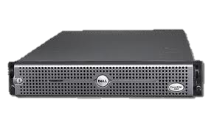
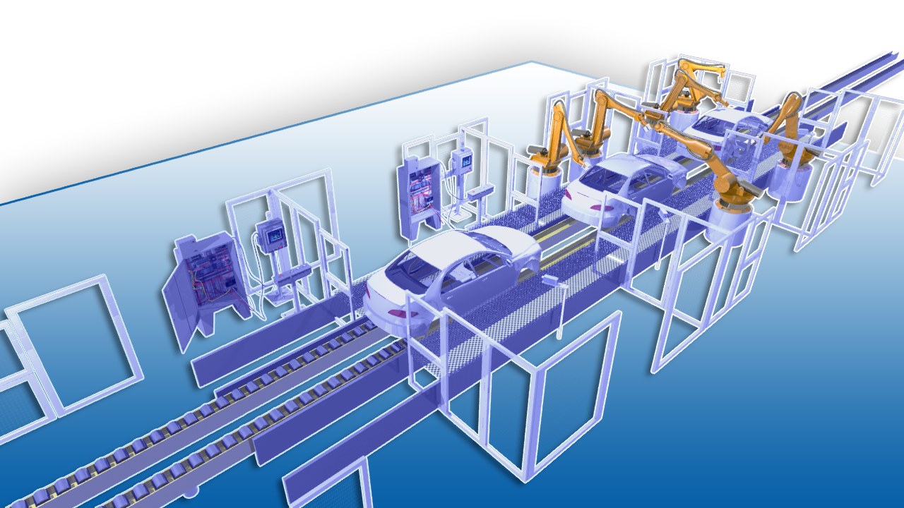
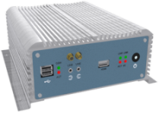
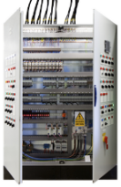
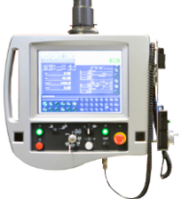
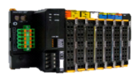
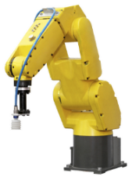
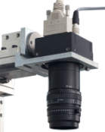


Intel ingredients in Industrial Automation
Data Center | Compute Performance I/O intensive
Factory server | Compute Performance I/O intensive
Industrial PC | Compute Performance Visualization/ UX RT Perf
PLC/PAC | I/O intensive Form Factor Sensitive RT Perf
HMI | Compute Performance Visualization/ UX Form Factor Sensitive
Remote IO | I/O intensive RT Perf
Robots | Compute Performance I/O intensive RT Perf
Machine visions | Compute Performance Form Factor Sensitive
Mobile workforce | Visualization/ UX Form Factor Sensitive

Slide 22

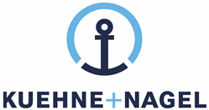

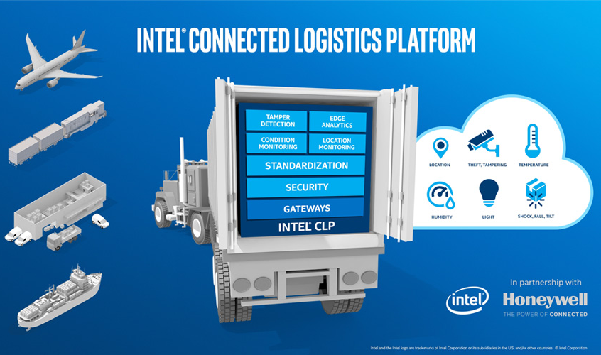
Honeywell connected freight
Asset Management
solution
Intel and Honeywell collaborate to develop 1st instantiation of Intel connected logistic platform through close partnership with key 3PL companies. The platform will deliver a cost effective and connected asset management solution.
Solution
Smart sensor tags with proprietary wireless sensor network
Intel based gateway with cellular and Wi-Fi connectivity
Analytics capability
End to end HW enabled security
Use Cases
Asset location tracking
Condition monitoring: Humidity, shock, tilt, fall, …
Logistic routing optimization
Speedier customs clearances
Customer satisfaction
Better forecasting
*Other names and brands may be claimed as the property of others.
https://www.honeywellaidc.com/solutions/workflow/connected-freight-solution
https://www.youtube.com/watch?list=PL6g2Y3N0CFAZUID8MIb48a33Lz3Hq0Y_8&v=zeRLY9ZanXA
Notes:
By Sahar/ Mauricio

Slide 23
Case Study Headlines
Fast Track IoT Smart Building, Industrial and City Solutions with Altiux and Intel
Altiux Helps Integrated Steel Plant Reduce ACC Energy Consumption by 18%
Altiux Helps Intelligent Glass Manufacturer Reduce On-site Maintenance Calls
Alleantia - Achieving the Power of Industry 4.0 with Plug-and-Play Simplicity
Intel Partner Simularity Delivers AI Software for Asset Monitoring
Cut Energy Costs with a Smart Real-Time Occupancy Solution from Feedback Solutions and Intel
The Infiswift IoT platform based on high-performance Intel® architecture enables more efficient agricultural operations.
Enabling data-driven insight and holistic visibility for Telco, service providers, and the enterprise
http://www.altiux.com/solution-brief-altiux-iot-and-intel.html
Notes:
This is an optional slide. Search for the whitepapers listed here if you would like to talk about this slide.

Slide 24
Where to Go from Here?
Continued Education and Training
Purchase Products
Get Product Information
Getting more Information on Intel Gateways
Contact an Account Rep.
Getting more Information on Intel Data Center
Notes:
Brian McCarthy
Survey for “Where to Go from here?”
Path to Product
List the Market Ready Solution

